Slide 1
Web Development

Slide 2
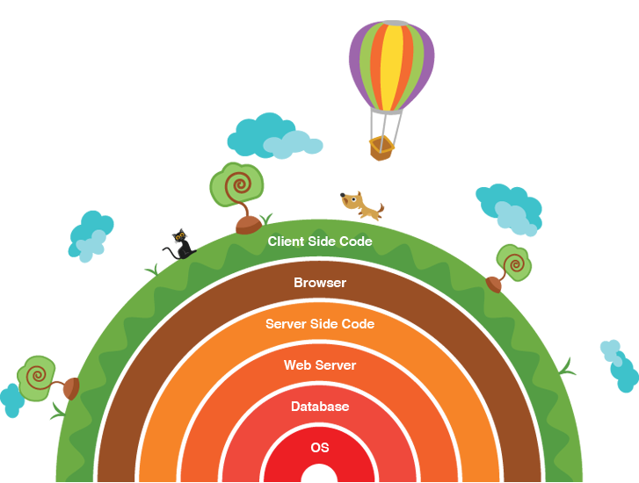
Definition
Web development broadly refers to the tasks associated with developing websites for hosting via intranet or internet. The web development process includes web design, web content development, client-side/server-side scripting and network security configuration, among other tasks.
The web development hierarchy is as follows:
Client-side coding
Server-side coding
Database technology

Slide 3

Client-side (Front-End Dev)
Deals with user interface and how the user interacts with the web (mainly through a web browser).
Languages:
JavaScript & associated libraries (jQuery)
CSS
HTML
AJAX

Slide 4
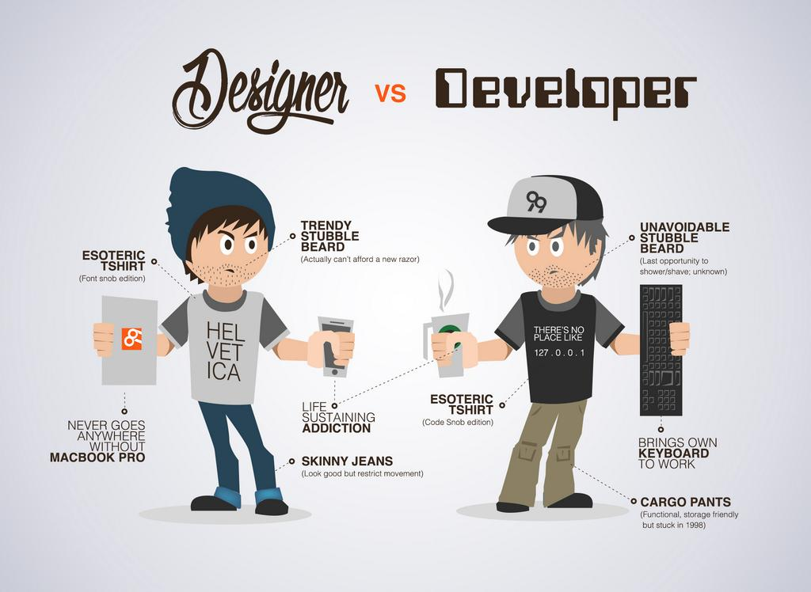

Slide 5
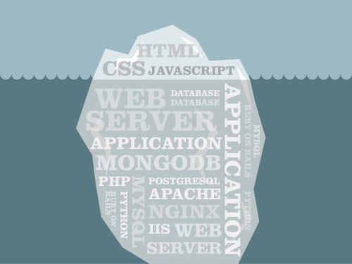
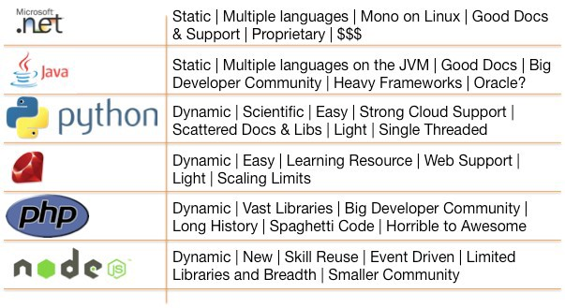
Server-side (Back-End Dev)
Maintain functional logic and operation of software
Server
Application
Database
Manipulation of data

Slide 6
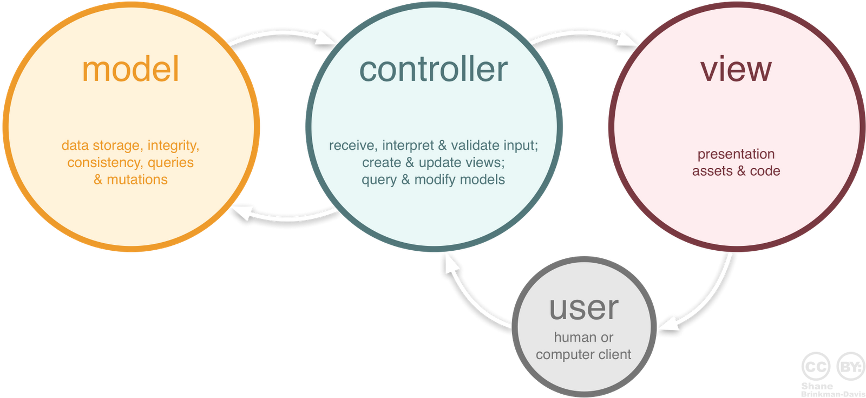
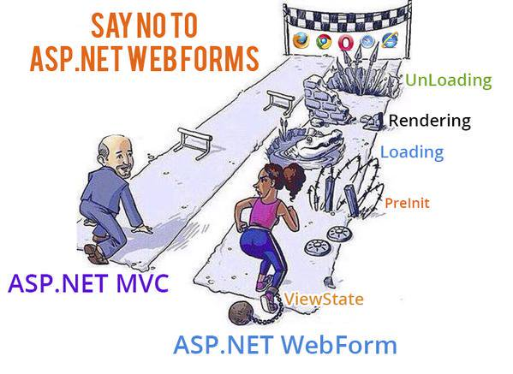
Architecture

